Slide 1
information visualisation
Alan Dix
Lancaster University and Talis
Birmingham
www.hcibook.com/alan/teaching/Promise2012/

Slide 2
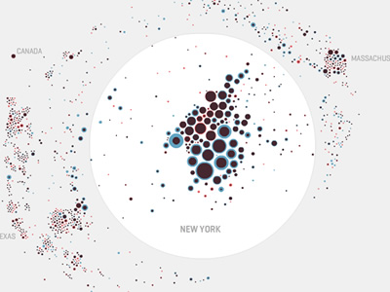
example Map your moves
where New Yorkers move (10 years data)
distorted map circle = moves for one zip code
red – out blue – in
overlaid
http://moritz.stefaner.eu/projects/map%20your%20moves/

Slide 3
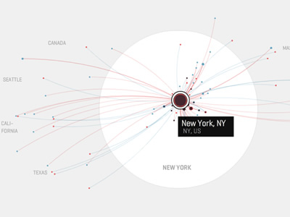
example Map your moves
interactive: selecting a zip code shows where movements to/from
also hiding: what you don’t show also important
http://moritz.stefaner.eu/projects/map%20your%20moves/

Slide 4
what is visualistion?
making data easier to understand using direct sensory experience
especially visual!
but can have aural, tactile ‘visualisation’

Slide 5
direct sensory experience
N.B. sensory rather than linguisitic
sort of right/left brain stuff!
but ... may include text, numbers, etc.

Slide 6
visualising in text alignment - numbers
think purpose!
which is biggest?
532.56 179.3 256.317 15 73.948 1035 3.142 497.6256

Slide 7
visualising in text alignment - numbers
visually:
long number = big number
align decimal points
or right align integers
627.865 1.005763 382.583 2502.56 432.935 2.0175 652.87 56.34

Slide 8
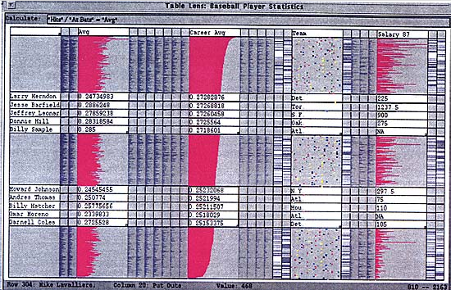
visualising in text TableLens
like a‘spreadsheet’ ...
... but some rows squashed to one pixel high
numbers become small histogram bars

Slide 9
visualising in text TableLens
N.B. also an example of focus+context
focus some rows in full detail
context whole dataset can also be seen in overview

Slide 10
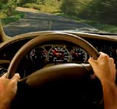
especially visual
visual cortex is 50% of the brain!
... but disability, context, etc., may mean non-visual forms needed

Slide 11
why visualisation?
for the data analyst
scientist, statistician, probably you!
for the data consumer audience, client, reader, end-user

Slide 12
why visualisation?
understanding
consumer
focus on well understood, simple representations
rhetoric

Slide 13
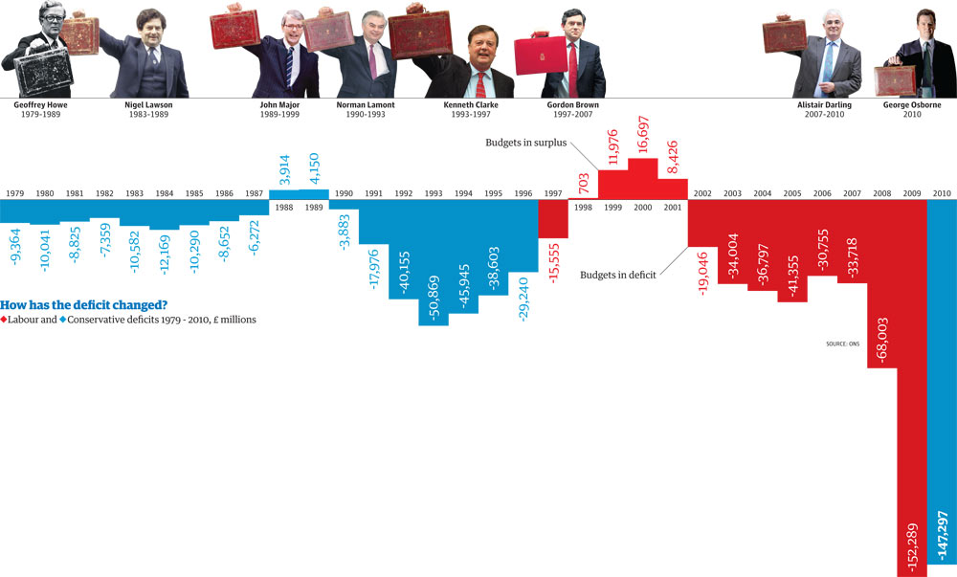
why visualisation?
to help others see what the analyst has already seen
understanding
consumer
infographics
rhetoric
data journalism
http://www.guardian.co.uk/news/datablog/2010/oct/18/deficit-debt-government-borrowing-data

Slide 14
why visualisation?
the business plan hockey stick!
understanding
consumer
rhetoric
to persuade readers of particular point (and not others!)
lies, damn lies, and graphs

Slide 15
why visualisation?
understanding
analyst
powerful, often novel visualisations, training possible
exploration

Slide 16
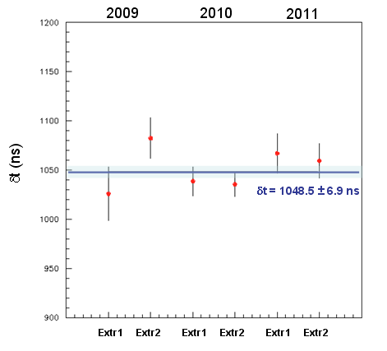
why visualisation?
to make more clear particular aspects of data
understanding
consumer
confirming hypotheses
exploration
noticing exceptions
e.g. box plots in stats
graph from: Measurement of the neutrino velocity with the OPERA detector in the CNGS beam

Slide 17
why visualisation?
seeking the unknown
understanding
avoiding the obvious
consumer
wary of happenstance
exploration
to find new things that have not been previously considered

Slide 19
a brief history of visualisation
from 2500 BC to 2012

Slide 20
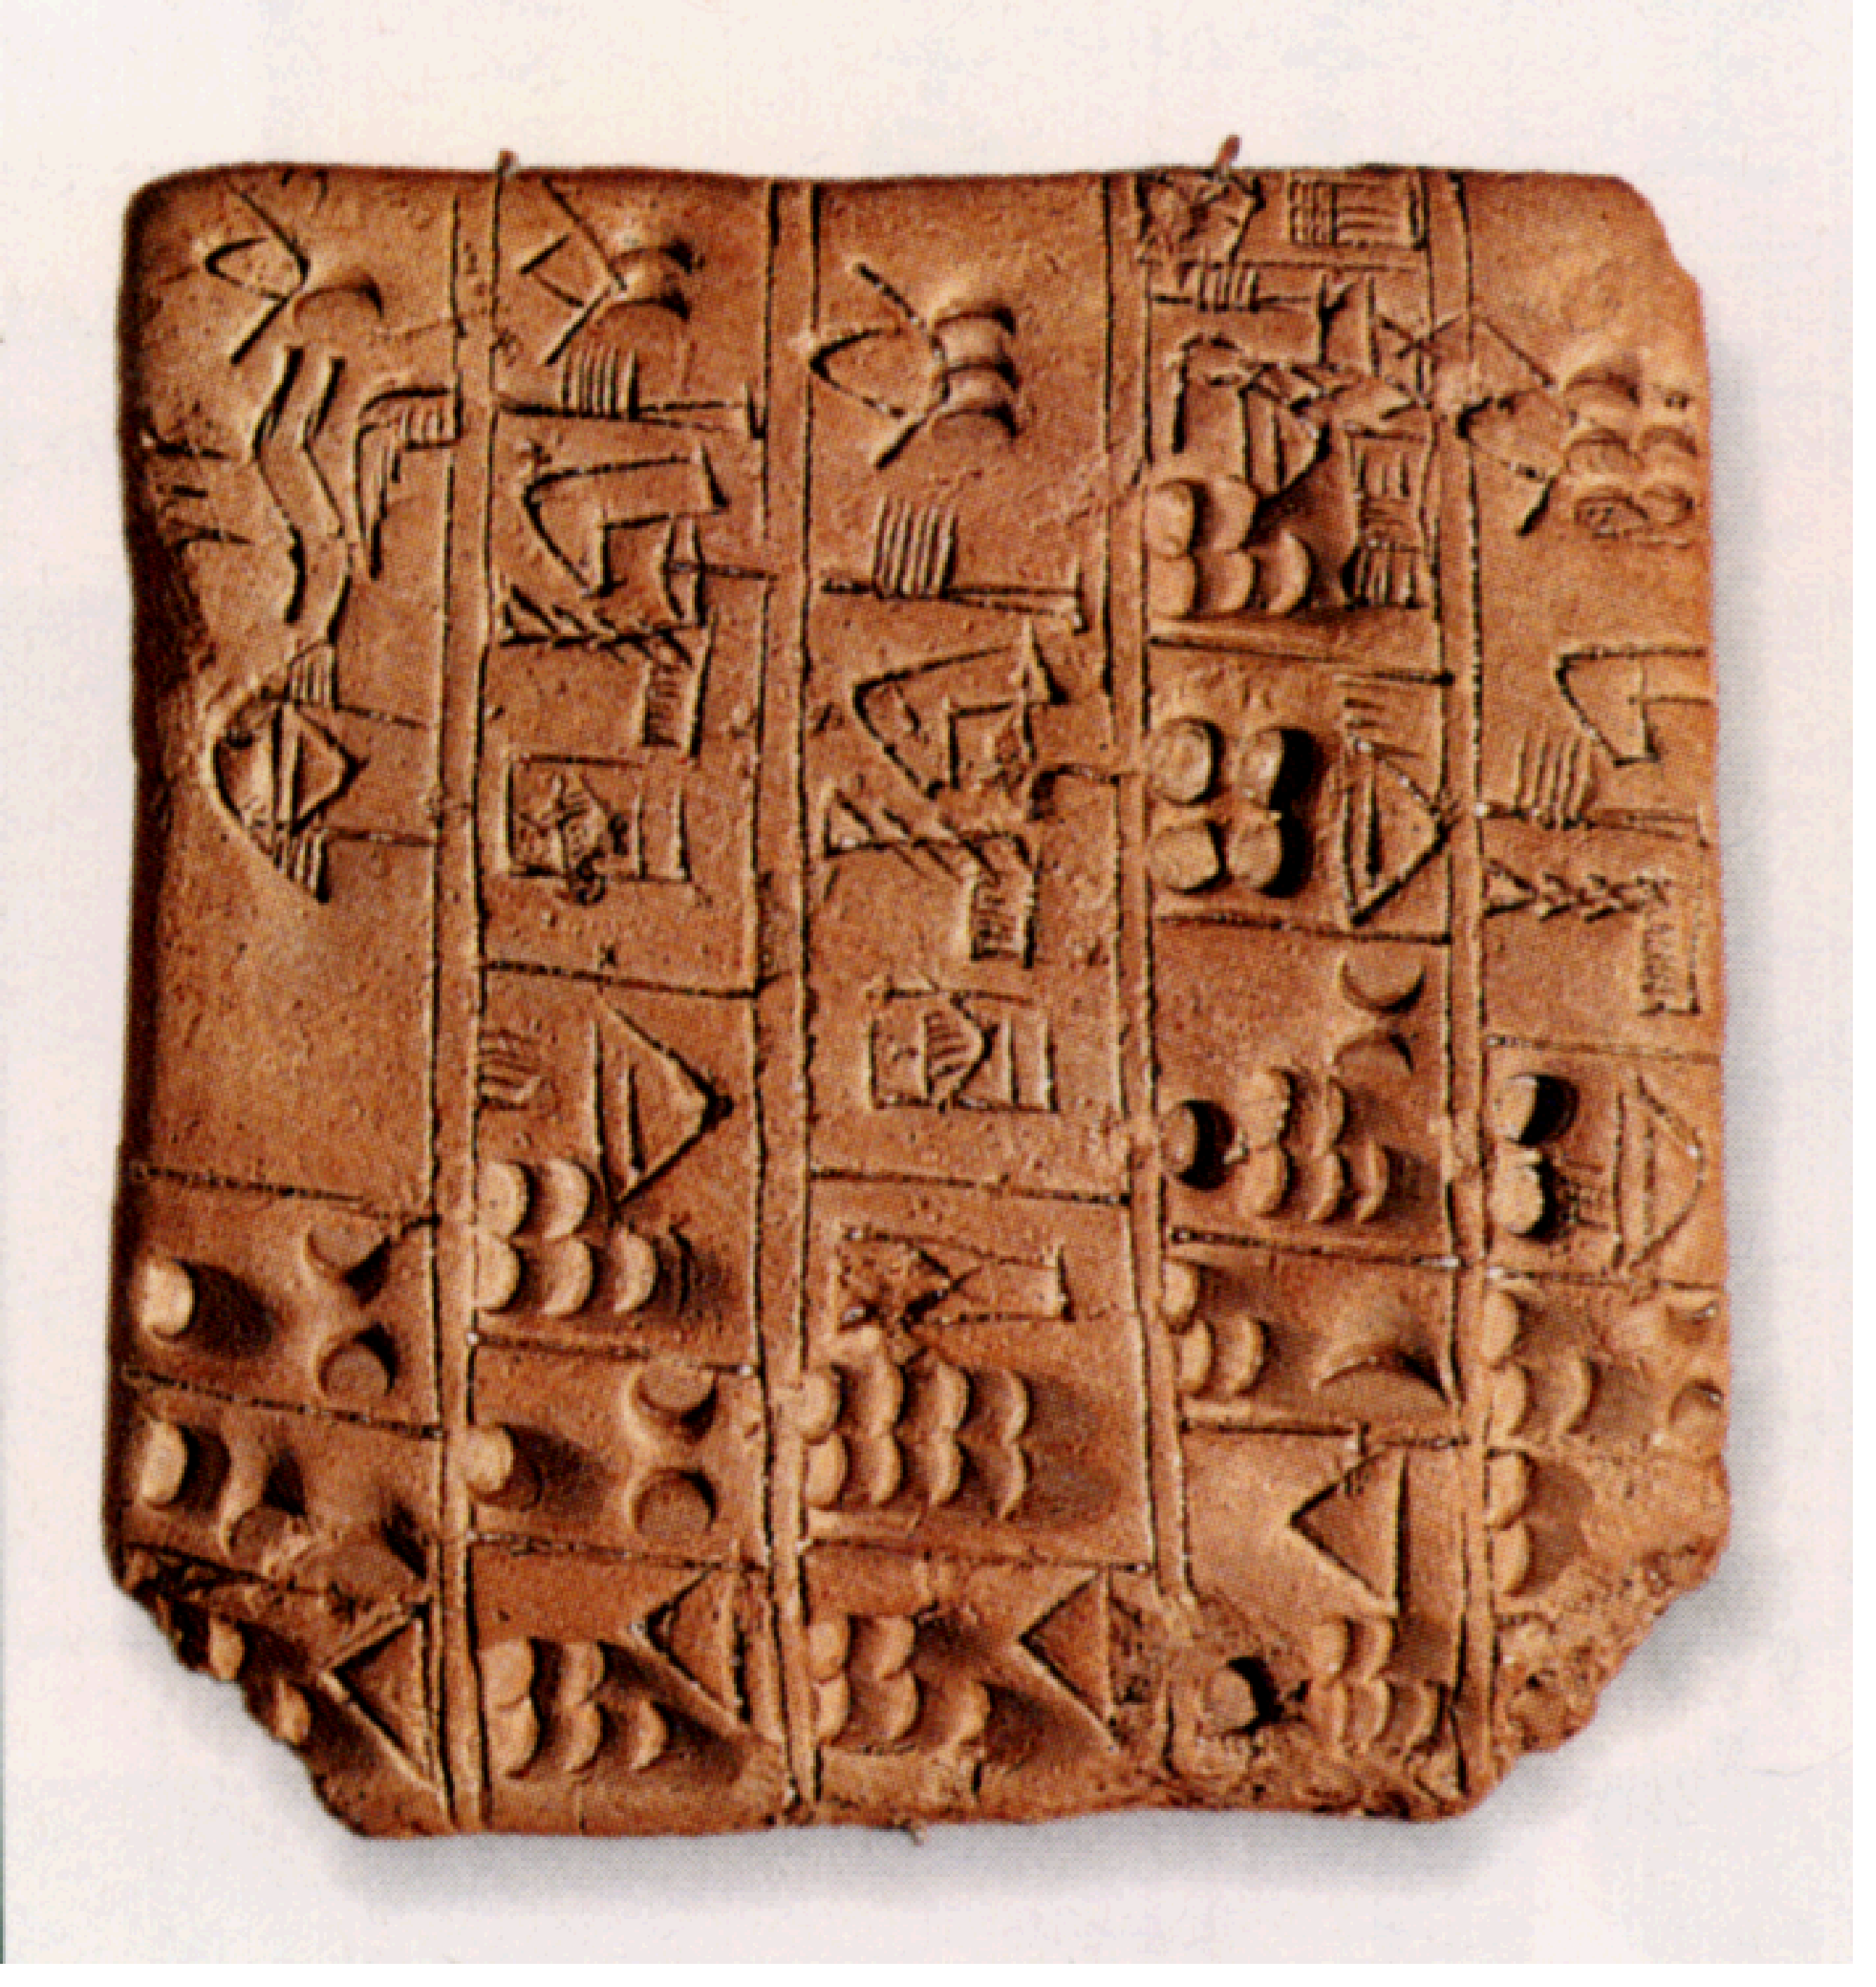
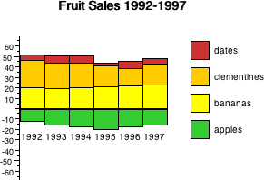
a brief history ...
static visualisation
the first 2500 years
interactive visualisation
the glorious ’90s
and now?
web and mass data
visual analytics

Slide 21
static visualisation from clay tablets to Tufte
Mesopotamian tablets

Slide 22
static visualisation from clay tablets to Tufte
Mesopotamian tablets
10th Century time line

Slide 23
static visualisation from clay tablets to Tufte
Mesopotamian tablets
10th Century time line
1855 Paris-Lyon train timetable

Slide 25
static visualisation from clay tablets to Tufte
Mesopotamian tablets
10th Century time line
1855 Paris-Lyon train timetable
Excel etc.

Slide 26
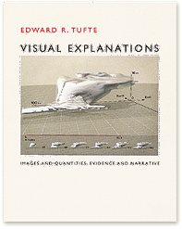
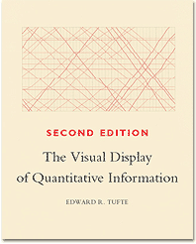
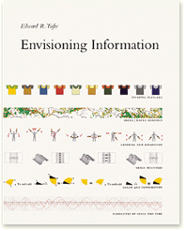
static visualisation
read Tufte’s books ...
The Visual Display of Quantitative Information
Envisioning Information
Visual Explanations

Slide 27
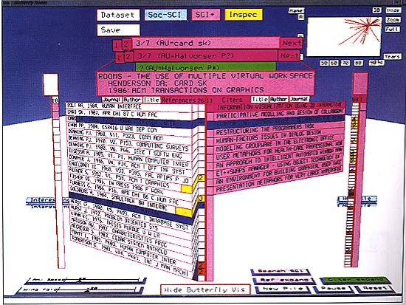
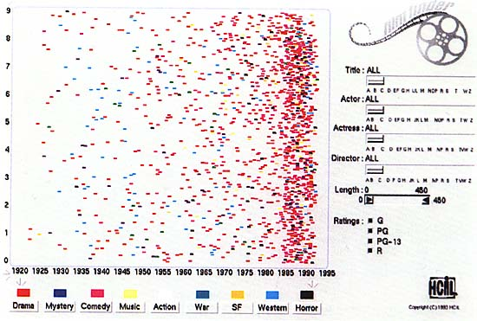
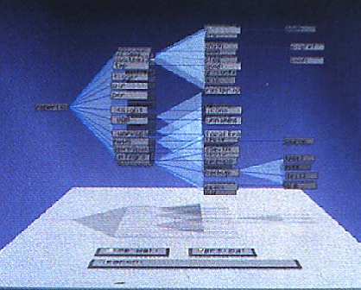
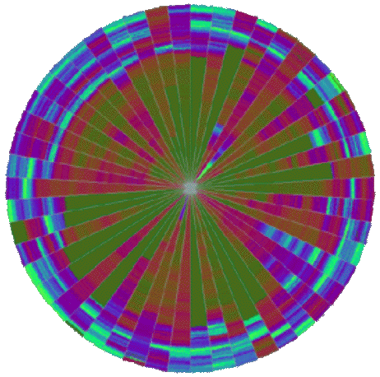
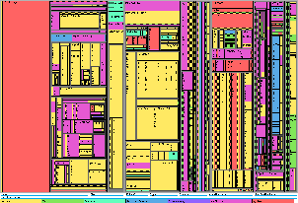
interactive visualisation
early 1990s growing graphics power
3D graphics
complex visualisations
real-time interaction possible

Slide 28
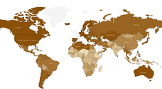
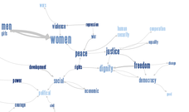
... and now
loads of data
web visualisation
data journalism
http://www.guardian.co.uk/news/datablog/2010/oct/18/deficit-debt-government-borrowing-data
http://www-958.ibm.com/software/data/cognos/manyeyes/

Slide 29
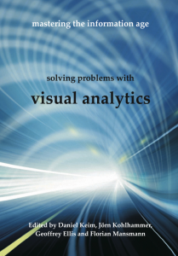
and visual analytics!

Slide 31
visualisation in context

Slide 32
plain visualisation
data
visualisation

Slide 33
visual analytics
data
visualisation
processing
direct interaction

Slide 34
the big picture
organisational social & political context
action
?
world
decision
data
visualisation
processing
direct interaction

Slide 36
designing visualisation

Slide 37
choosing representations
visualisation factors
visual ‘affordances’
what we can see
objectives, goals and tasks
what we need to see
aesthetics
what we like to see
what we can see
what we need to see
what we like to see

Slide 38
trade-off
visualisation factors
visual affordances
objectives, goals and tasks
aesthetics
static representation ⇒ trade-off
interaction reduces trade-off
stacking histogram, overview vs. detail, etc. etc.
interaction reduces trade-off
stacking histogram, overview vs. detail, etc. etc.

Slide 39
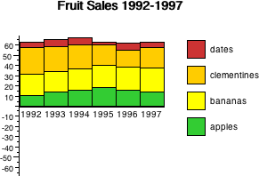
relaxing constraints
normal stacked histogram
good for:
overall trend
relative proportions
trend in bottom category
bad for others
what is happening to bananas?
?

Slide 40
make your own (iii) relaxing constraints
interactive stacking histograms ... or ... dancing histograms
normal histogram except ...
dancing histograms
normal histogram except ...

Slide 41
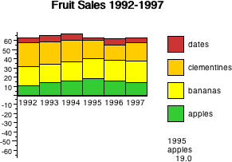
make your own (iii) relaxing constraints
interactive stacking histograms ... or ... dancing histograms
normal histogram except ...
hover over cell to show detail

Slide 42
make your own (iii) relaxing constraints
interactive stacking histograms ... or ... dancing histograms
normal histogram except ...
hover over cell to reveal detail
click on legend to change baseline
demonstration

Slide 43
kinds of interaction
highlighting and focus
drill down and hyperlinks
overview and context
changing parameters
changing representations
temporal fusion

Slide 44
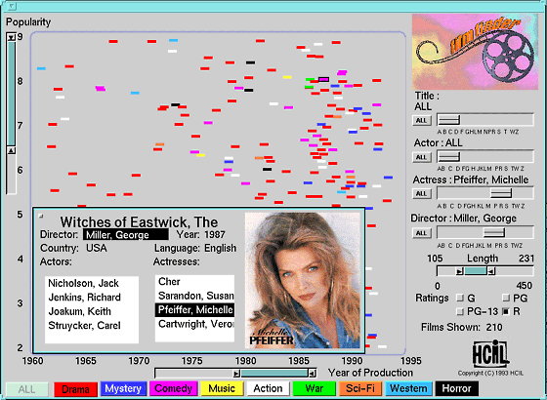
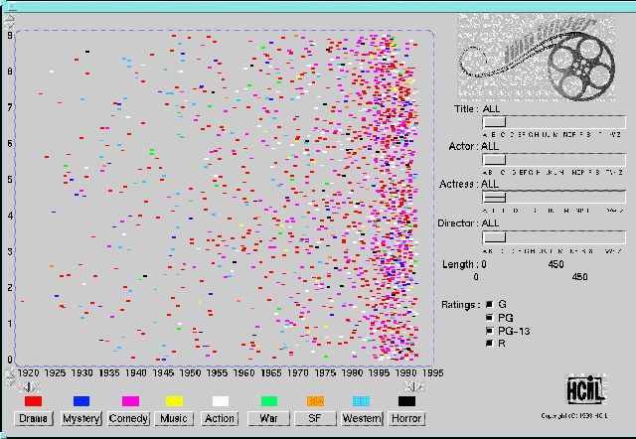
Shneiderman’s visualisation mantra
overview first,
zoom and filter,
then details on demand
overview
zoom and filter using sliders
details on demand
http://www.sapdesignguild.org/community/book_people/visualization/controls/FilmFinder.htm

Slide 46
classic visualisations

Slide 47
displaying groups/clusters
numeric attributes
use average or region
categorical attributes
show values of attributes common to cluster
text, images, sound
no sensible ‘average’ to display
use typical documents/images
central to cluster ... or spread within cluster

Slide 48
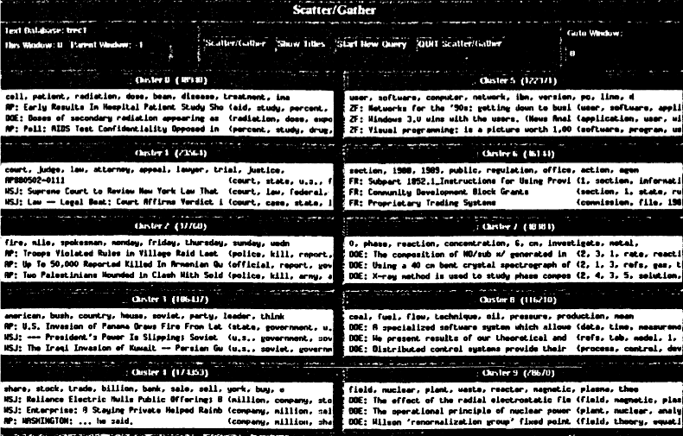
using clusters the scatter/gather browser
take a collection of documents
scatter:
group into fixed number of clusters
displays clusters to user
gather:
user selects one or more clusters
system collects these together
scatter:
system clusters this new collection ...

Slide 49
displaying clusters scatter-gather browser
keywords (created by clustering algorithm)
‘typical’ documents (with many cluster keywords)

Slide 50
hierarchical data
hierarchies are everywhere!
file systems
organisation charts
taxonomies
classification trees
ontologies
xml

Slide 51
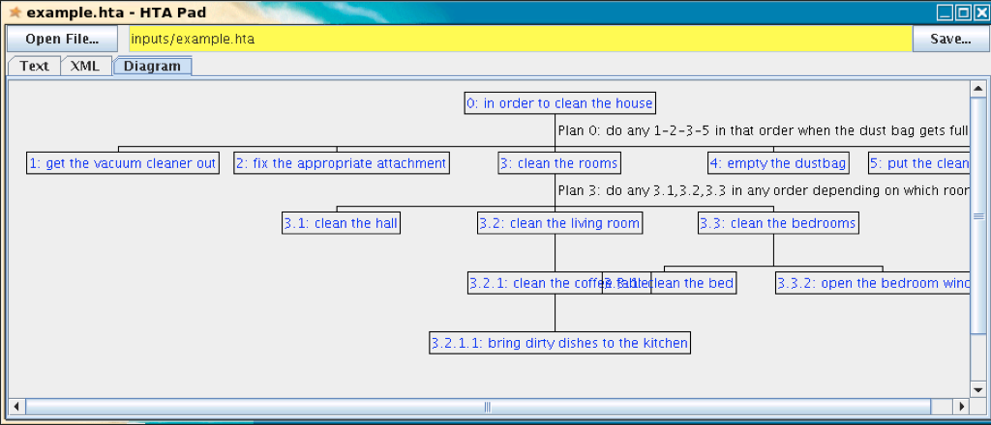
problems with trees ...
hard to fit text labels
width grows rapidly
overlapping low level nodes

Slide 52
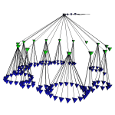
use 3D?
cone tree
use stacked circles of subtrees

Slide 53
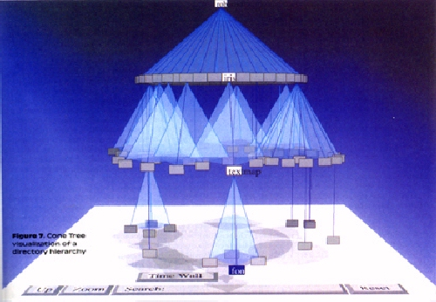
good use of 3D
still have occlusion ... but ‘normal’ in 3D
shadows help to disambiguate
but text labels difficult

Slide 54
cone trees → cam trees
horizontal layout makes labels readable
small things matter!

Slide 55
disect 2D space - treemaps
takes tree of items with some ‘size’
e.g. file hierarchy, financial accounts
alternatively divides space horizontally/vertically for each level, proportionate to total size
x [6]
y [3]
x
x/a – 4
x/b – 2
y
y/c – 1
y/d – 1
y/e – 1
x/a [4]
y/c [1]
y/d [1]
x/b [2]
y/e [1]
http://www.cs.umd.edu/hcil/treemap-history/

Slide 56
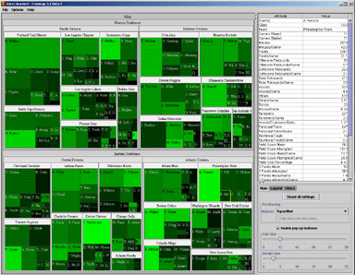
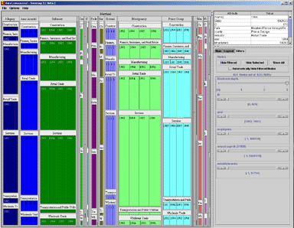
treemaps (2)
later variants improved the shape and appearance of maps

Slide 57
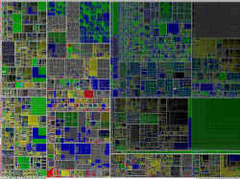
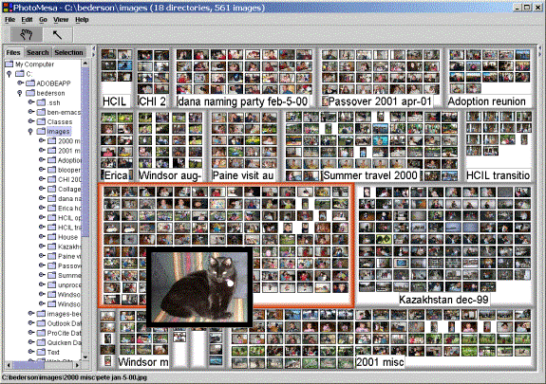
treemaps (3)
plus algorithms for vast data sets, for thumbnail images, etc. etc.

Slide 58
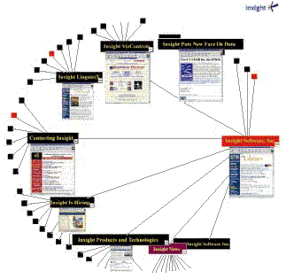
distort space ...
tree branching factor b:
number of nodes at depth d = b^{d}
Euclidean 2D space:
amount of space at radius r = 2πr
not enough space!
non-Euclidean hyperbolic space:
exponential space at radius r
hyperbolic browser
lays out tree in hyperbolic space
then uses 2D representation of hyperbolic space

Slide 59
multiple attributes
often data items have several attributes
e.g. document:
type (journal, conference, book)
date of publication
author(s)
multiple keywords (perhaps in taxonomy)
citation count
popularity

Slide 60
traditional approach ... boolean queries
new query
type=‘journal’ and keyword=‘visualisation’
query processing complete - 2175 results list all (Y/N)
N
refine query
refine: type=‘journal’ and keyword=‘visualisation’
author=‘smith’
query processing complete - 0 results

Slide 61
faceted browsing e.g. HiBrowse (one of the earliest)
multiple selection boxes
‘or’ within box - ‘and’ between boxes
keywords
authors
types
digital libraries
HCI 173
formal models
interaction 157
task analysis
visualisation 39
web
all 173
catarci 53
dix 9
jones 17
shneiderman 153
smith 0
wilson 22
all 173
book
conference
journal 173
other
(keyword=‘interaction’ or ‘visualisation’) and type=‘journal’

Slide 62
HiBrowse (ii)
shows how many items with particular value
e.g. 39 documents with keyword=‘visualisation’ and type=‘journal’
e.g. 39 documents with keyword=‘visualisation’ and type=‘journal’
keywords
authors
types
digital libraries
HCI 173
formal models
interaction 157
task analysis
visualisation 39
web
all 173
catarci 53
dix 9
jones 17
shneiderman 153
smith 0
wilson 22
all 173
book
conference
journal 173
other

Slide 63
HiBrowse (iii)
can predict the effect of refining selection
e.g. selecting ‘smith’ would give empty result
e.g. selecting ‘smith’ would give empty result
keywords
authors
types
digital libraries
HCI 173
formal models
interaction 157
task analysis
visualisation 39
web
all 173
catarci 53
dix 9
jones 17
shneiderman 153
smith 0
wilson 22
all 173
book
conference
journal 173
other

Slide 64
HiBrowse (iv)
refining selection updates counts in real time
keywords
authors
types
all 173
catarci 53
dix 9
jones 17
shneiderman 153
smith 0
wilson 22
all 39
catarci 18
dix 1
jones 3
shneiderman 21
smith 0
wilson 7
digital libraries
HCI 39
formal models
interaction
task analysis
visualisation 39
web
all 45
catarci 19
dix 1
jones 5
shneiderman 24
smith 0
wilson 8
digital libraries
HCI 45
formal models
interaction
task analysis
visualisation 45
web
all 173
book
conference
journal 173
other
all 39
book
conference
journal 39
other
digital libraries
HCI 173
formal models
interaction 157
task analysis
visualisation 39
web
all 45
book 6
conference
journal 39
other

Slide 65
starfield (i)
scatter plot for two attributes colour/shape codes for more
adjust rest with sliders dots appear/disappear as slider values change
dynamic filtering

Slide 66
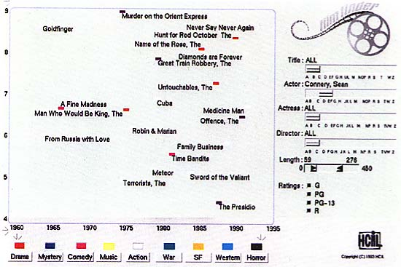
starfield (ii)
when few enough points more details appear

Slide 67
Influence Explorer (i)
developed for engineering models
like Starfield ... but sliders show histogram
how many in category (like HiBrowse) ... and how many ‘just miss’
red = full match
black = all but one attribute
greys = fewer matching attr’s

Slide 68
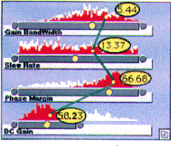
Influence Explorer (ii)
some versions highlight individual items in each histogram
similar technique has been used to match multiple taxonomic classifications

Slide 69
Information Scent
Starfield shows what is currently selected
explore using trial and error
HiBrowse and Influence Explorer show what would happen
Pirolli et al. call this Information Scent
things in the interface that help you know what actions to take to find the information you want

Slide 70
very large datasets
too many points/lines to see
solutions ...
space-filling single-pixel per item Keim’s VisD
random selection (see Geoff Ellis’ thesis)
clustering visualise groups not individuals

